Slide 1
Secure SMS exchange. RC6 + Blind RSA signature + DH key exchange
RAMI AMASHA & JASMEEN MURA.

Slide 2
protocol
1) Generate private key for both sides via DH key exchange+ BLIND RSA for digital signature.
2) form the shared key generate round keys according to algorithm RC6 key generation step.
3) each message is encrypted\ decrypted via RC6 algorithm and with blind RSA for digital signature .

Slide 3
Rc6 Key generation
Step 1 : Generate Round keys
r- number of rounds. Value= 12 rounds
w- word size in bits. Value=32 bits
b- length of user key in bytes.
s- array to store the generated round keys. Its length = 2*r+4
Formula :
s[i] = (s[i-1] + 0x9E3779B9) % (2^w) , s[0]=0xB7E15163

Slide 4
Rc6 Key generation
Step 2: Converting User Key
Convert the user provided key to binary blocks
Purpose:
to transform the user-provided key into a format that is compatible with the subsequent operations in the RC6 key generation process such as bitwise operations, modular arithmetic

Slide 5
Rc6 Key generation
Step 3: Reversing and Storing Encoded Key
Take the binary blocks from the previous step in store it in reverse in array l.
Purpose:
In RC6 algorithm we make key mixing, it involves performing operations between the generated round keys and the encoded key blocks.

Slide 6
Rc6 Key generation
Step 4: Key Mixing and Round Key Generation
the round keys and encoded key blocks are mixed together using bitwise operations.
Formula for A mixing: A =s[i]= (s[i] + A + B) % modulo
Formula for B mixing: B =l[i]= (l[j] + A + B) % modulo

Slide 7

RC6 Intro.
RC6 is a symmetric key algorithm for block encryption.
Notation:
$RC6 −w,r,b$
Where: 1) w is the word size.
2) r non terrible quantity of rounds
3) b byte size of encryption key.
RC6 is primarily based on seven primitive operations .
Note: in our implementation we used : w=32, r=12, b=128.

Slide 8
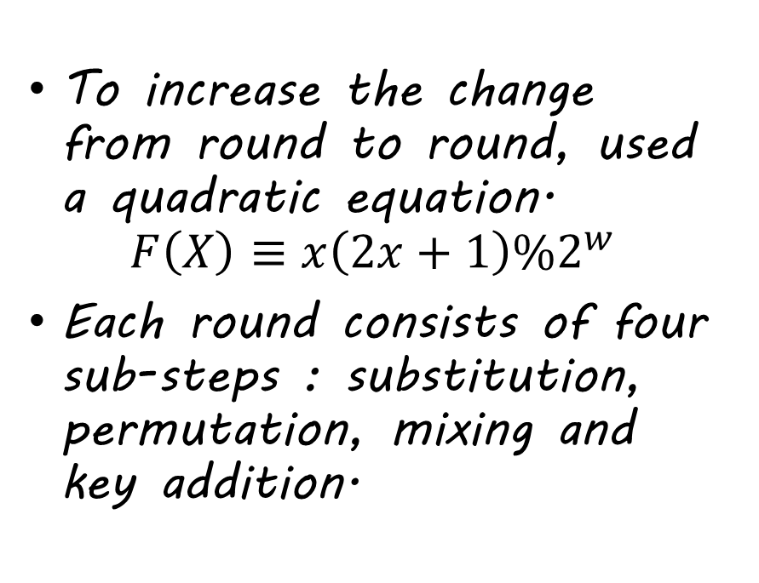
RC6 Intro. Cont.
To increase the change from round to round, used a quadratic equation.
$$F\left(X\right)≡x\left(2x+1\right)\%2^{w}$$
Each round consists of four sub-steps : substitution, permutation, mixing and key addition.

Slide 9
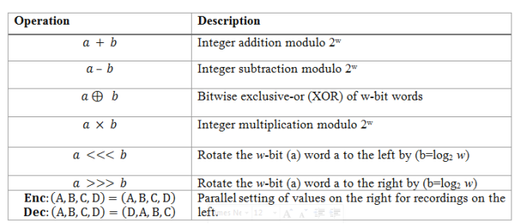
Primitive operations of RC6

Slide 10
RC6.The sub-steps
1) Substitution step employs bitwise rotations, which involve shifting the bits of the data block to the left or right.
Purpose of substitution : to introduce non-linearity in the encryption process.
2) Permutation step involves rearranging the positions of the bits within the data block.
Purpose of Permutation: to spread the influence of individual bits across the entire data block, achieving diffusion. Also ensures that any changes or manipulations in one part of the data block will have a cascading effect throughout the block.

Slide 11
RC6.The sub-steps
3) Mixing :
refers to the process of combining and manipulating the data block with round keys.
Mixing operations are applied during each round of the encryption process to enhance the security and complexity of RC6.
There are typically two types of mixing operations in RC6: bitwise XOR and modular addition/subtraction.
Purpose of Mixing: By combining the data block with the round key using XOR and modular operations, mixing ensures that the relationship between the plaintext, the key, and the encrypted output becomes highly complex.

Slide 12
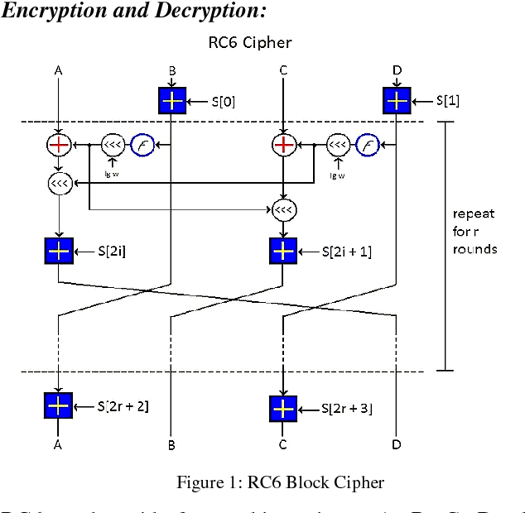

Slide 13
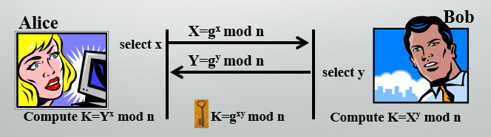
DH Key Exchange Algorithm

Slide 14

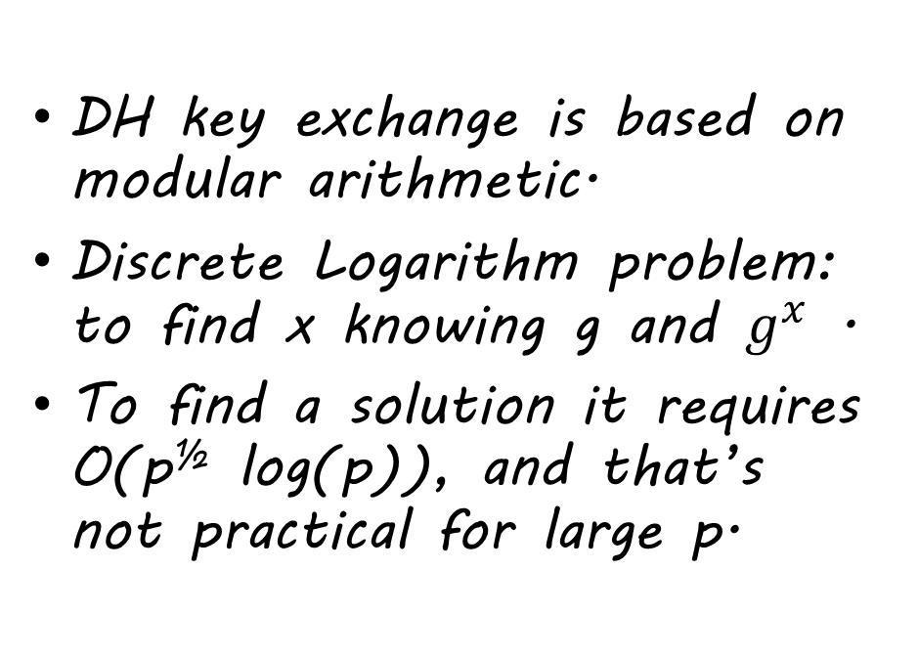
DH Key exchange Cont.
DH key exchange is based on modular arithmetic.
Discrete Logarithm problem: to find x knowing g and $g^{x}$ .
To find a solution it requires O(p^{½} log(p)), and that’s not practical for large p.

Slide 15
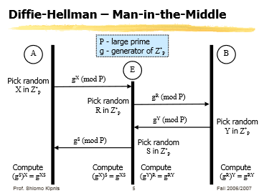
DH Key exchange Cont. PROBLEM
Man in the middle !

Slide 16
DH key exchange - Vulnerabilities and Mitigations
Mitigation | Vulnerability
Use strong random number generators for generating private keys. - Ensure private keys are sufficiently long and resistant to guessing or brute-force attacks. | Weak Key Generation
- Choose longer key lengths to increase computational effort required for brute-force attacks. - Follow recommended key length guidelines for the chosen cryptographic algorithm. | Key Length
Securely store and handle private keys. - Implement proper key rotation and revocation procedures. | Key Management

Slide 17
Digital signatures
Digital signatures provide a solution by employing cryptographic techniques to create unique signatures that can be verified by recipients.
It also provide the ability to:
verify author, date & time of signature
authenticate message contents
be verified by third parties to resolve disputes

Slide 18
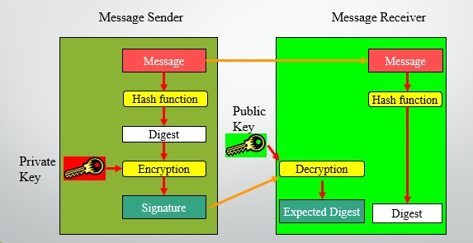
Digital Signature Generation and Verification

Slide 19
RSA Blind digital signature – Need for blind signatures
Blind signatures are used in scenarios where the signer should not have knowledge of the message being signed.
Common applications of blind signatures include electronic voting systems and digital contracts.
In electronic voting, blind signatures allow voters to keep their votes private while still verifying their authenticity.
By using blind signatures, both the privacy of the signer and the integrity of the message are preserved, ensuring secure and unbiased transactions.

Slide 20

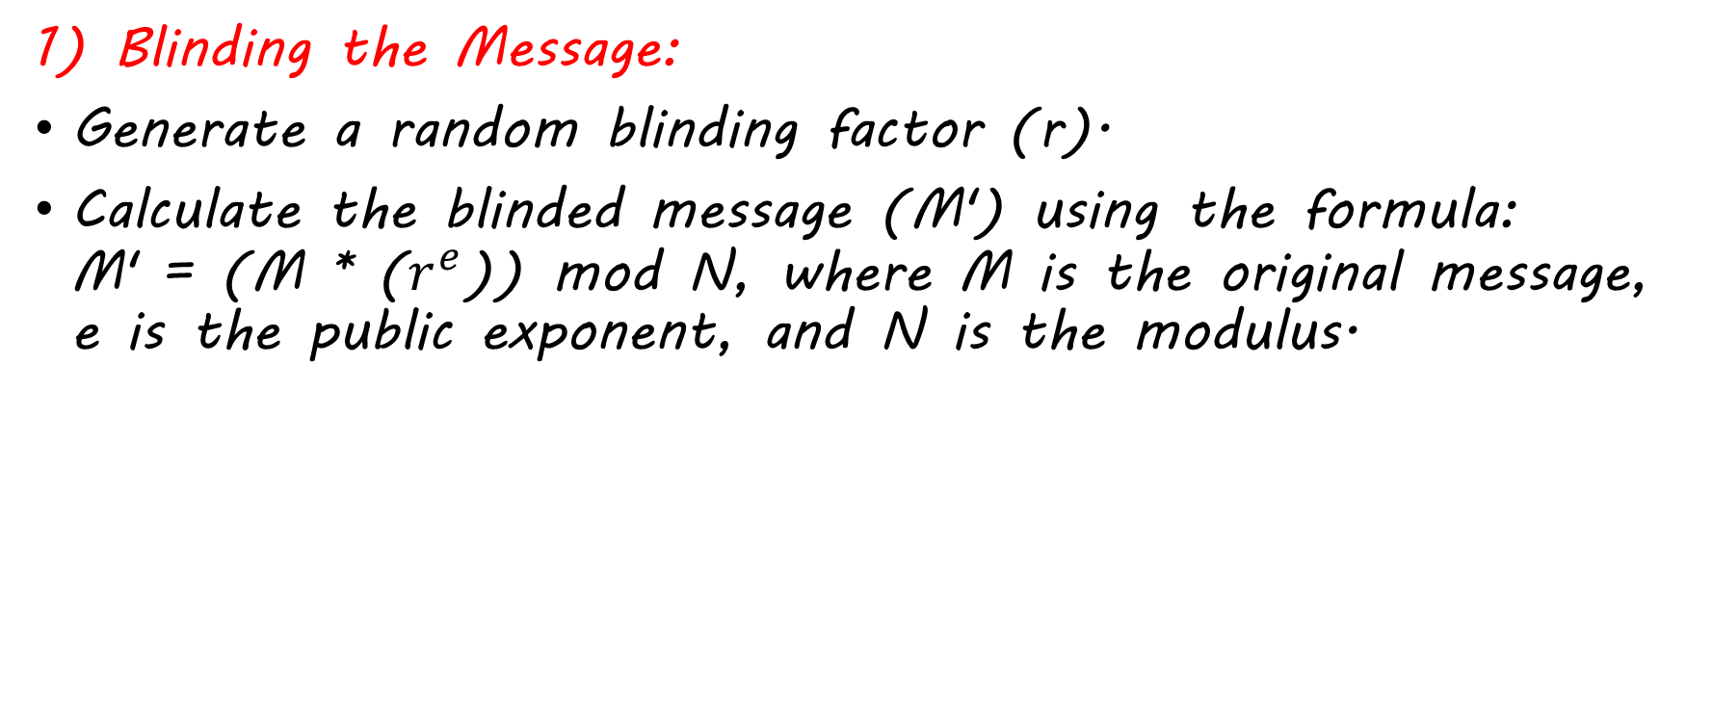
Blind RSA scheme
1) Blinding the Message:
Generate a random blinding factor (r).
Calculate the blinded message (M') using the formula: M' = (M * ($r^{e}$)) mod N, where M is the original message, e is the public exponent, and N is the modulus.
Requester

Slide 21


Blind RSA scheme Cont.
2) Signing the Blinded Message:
Use the private key (d) to sign the blinded message (M') and obtain the blinded signature (S'): S' = ($M^{′d}$) mod N.
Signer

Slide 22

Requester
3) Unblinding the Signature:
Compute the inverse of the blinding factor ($r^{−1}$) using the extended Euclidean algorithm.
Unblind the blinded signature (S') to obtain the unblinded signature (S) using the formula: S = (S' * ($r^{−1}$)) mod N.

Slide 23
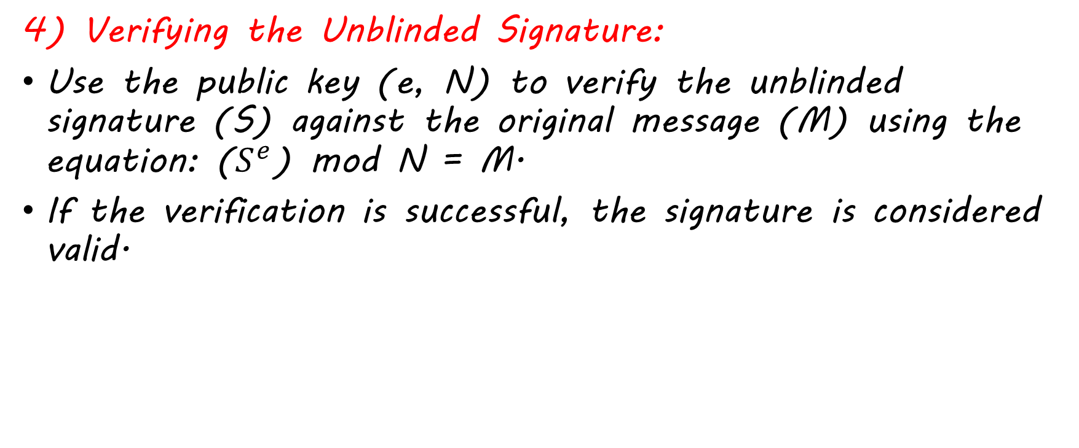
Blind RSA scheme Cont.
4) Verifying the Unblinded Signature:
Use the public key (e, N) to verify the unblinded signature (S) against the original message (M) using the equation: ($S^{e}$) mod N = M.
If the verification is successful, the signature is considered valid.
Requester

Slide 24
Security properties of Blind RSA
Un-linkability: Blind RSA signatures ensure the un-linkability between the signed message and the identity of the signer. Since the signer does not have knowledge of the original message during the signing process, it becomes computationally infeasible for anyone to determine the relationship between the signed message and the signer's identity.

Slide 25
Security properties of Blind RSA Cont.
Integrity: The unblinded signature, obtained by the requester after unblinding the blinded signature, guarantees the integrity of the original message. Any tampering or alteration of the message would result in a failed verification of the unblinded signature.

Slide 26
Security properties of Blind RSA Cont.
Authenticity: The blind RSA signature scheme ensures the authenticity of the unblinded signature. By using the public key and the original message, the requester can verify that the unblinded signature was indeed produced by the signer who possesses the corresponding private key.

Slide 27

Put all together
Key generation:
1) generate RSA key pair for the server.
2) RC6 key.

Slide 28
DH Key exchange
1) Key Generation: Alice and Bob generate their private DH exponents and RSA key pairs.
2)RSA Signature: Alice and Bob sign their DH public keys with their RSA private keys.
3)Exchange of Signed Public Keys: Alice and Bob send their DH public keys and their RSA signatures to each other.
4)RSA Signature Verification: Alice and Bob verify the received signed public keys using the sender's RSA public key.

Slide 29
5)Alice asks Bob to sign the shared secret key as described earlier, if verified then its indeed Bob. (Same for Bob)

Slide 30
Put it all together Cont.
Message sending (Sender = Alice)➔
1) generate random blinding factor.
2) Alice computes the blinded message by hashing the blinding factor concatenated with the actual message: blinded_message = SHA256(blinding_factor + message).

Slide 31
Put it all together Cont.
3) Blind the message using the server's public key: compute blind_message = blinded_message^e mod N, where e is the public exponent of the server's RSA key and N is the modulus.
4) Alice encrypts the blinded message using her RC6 encryption key.
5) Alice sends the encrypted and blinded message to the server

Slide 32
Put it all together Cont.
Message Storage and Delivery: (server)
The server receives the encrypted and blinded message from Alice and stores it securely without knowing Alice's identity or the message content.
The server generates a signature on the encrypted message using its private key: signed_blind_message = blind_message^d mod N.
The server stores the signature along with the encrypted message.

Slide 33
Put it all together Cont.
Message Retrieval:
Recipient (Bob):
Bob retrieves the encrypted and blinded message from the server along with the server's signature from the server.

Slide 34
Put it all together Cont.
Message Verification and Unblinding:
1)Bob decrypts the encrypted message using his RC6 encryption key.
2)Bob verifies the signature of the message using the server's public key.
verified_blind_message = signed_blind_message^e mod N.
3)Bob cannot directly access the original message due to the blinding factor.

Slide 35
Put it all together Cont.
4)If needed, Bob can communicate with Alice through a secure channel provided by the server to gather additional information or clarify details.

Slide 36
Bibliography
Course lectures:
* Public Key Cryptology Diffie-Hellman Key Exchange
* RSA
*Digital Signatures
Encryption Image by Using RC6 and Hybrid Chaotic Map https://www.webology.org/data-cms/articles/20201217051701pmWEB17024.pdf
"Blind Signature Schemes" by Birgit Pfitzmann (2001) https://www.cosic.esat.kuleuven.be/nessie/reports/e5.pdf
"Understanding Cryptography: A Textbook for Students and Practitioners" by Christof Paar and Jan Pelzl (2010) https://www.crypto-textbook.com/

